Slide 1
Two-Way Independent ANOVA (GLM 3)
Prof. Andy Field

Slide 2
Aims
Rationale of factorial ANOVA
Partitioning variance
Interaction effects
  Interaction graphs
  Interpretation

Slide 3
What is Two-Way Independent ANOVA?
Two independent variables
  Two-way = 2 Independent variables
  Three-way = 3 Independent variables
Different participants in all conditions
  Independent = ‘different participants’
Several independent variables is known as a factorial design.

Slide 4
Benefit of Factorial Designs
We can look at how variables interact.
Interactions
  Show how the effects of one IV might depend on the effects of another
  Are often more interesting than main effects.
Examples
  Interaction between hangover and lecture topic on sleeping during lectures.
    A hangover might have more effect on sleepiness during a stats lecture than during a clinical one.

Slide 5
An Example
Field (2009): Testing the effects of alcohol and gender on ‘the beer-goggles effect’:
  IV 1 (Alcohol): none, 2 pints, 4 pints
  IV 2 (Gender): male, female
Dependent variable (DV) was an objective measure of the attractiveness of the partner selected at the end of the evening.

Slide 6
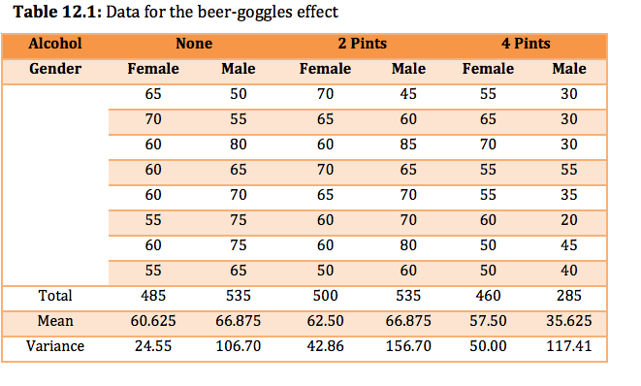

Slide 7
SS_{T} (8967)
Variance between all scores
SS_{M}
Variance explained by the experimental manipulations
SS_{R}
Error Variance
SS_{A}
Effect of Alcohol
SS_{B}
Effect of Gender
SS_{A × B}
Effect of Interaction

Slide 8
Step 1: Calculate SS_{T}
65 | 50 | 70 | 45 | 55 | 30
50 | 55 | 65 | 60 | 65 | 30
70 | 80 | 60 | 85 | 70 | 30
45 | 65 | 70 | 65 | 55 | 55
55 | 70 | 65 | 70 | 55 | 35
30 | 75 | 60 | 70 | 60 | 20
70 | 75 | 60 | 80 | 50 | 45
55 | 65 | 50 | 60 | 50 | 40
Grand Mean = 58.33

Slide 9
Step 2: Calculate SS_{M}

Slide 10
Step 2a: Calculate SS_{A}
A₁: Female |  |  |  | A₂: Male
65 | 70 | 55 |  | 50 | 45 | 30
70 | 65 | 65 |  | 55 | 60 | 30
60 | 60 | 70 |  | 80 | 85 | 30
60 | 70 | 55 |  | 65 | 65 | 55
60 | 65 | 55 |  | 70 | 70 | 35
55 | 60 | 60 |  | 75 | 70 | 20
60 | 60 | 50 |  | 75 | 80 | 45
55 | 50 | 50 |  | 65 | 60 | 40
Mean Female = 60.21 |  |  |  | Mean Male = 56.46

Slide 11
Step 2b: Calculate SS_{B}
B₁: None |  |  | B₂: 2 Pints |  |  | B₃: 4 Pints
65 | 50 |  | 70 | 45 |  | 55 | 30
70 | 55 |  | 65 | 60 |  | 65 | 30
60 | 80 |  | 60 | 85 |  | 70 | 30
60 | 65 |  | 70 | 65 |  | 55 | 55
60 | 70 |  | 65 | 70 |  | 55 | 35
55 | 75 |  | 60 | 70 |  | 60 | 20
60 | 75 |  | 60 | 80 |  | 50 | 45
55 | 65 |  | 50 | 60 |  | 50 | 40
Mean None = 63.75 |  |  | Mean 2 Pints = 64.6875 |  |  | Mean 4 Pints = 46.5625

Slide 12
Step 2c: Calculate SS_{A × B}

Slide 13
Step 3: Calculate SS_{R}
Notes:
The residual sum of squares is calculated in the same way as for one-way ANOVA and again represents individual differences in performance or the variance that can’t be explained by factors that were systematically manipulated. We saw in one-way ANOVA that the value is calculated by taking the squared error between each data point and its corresponding group mean. An alternative way to express this was as in equation 1 in the slide.
So, we use the individual variances of each group and multiply them by one less than the number of people within the group (n). We have the individual group variances in our original table of data (first page of this handout) and there were eight people in each group (therefore, n = 8) and so the equation becomes the second equation on the slide.
The degrees of freedom for each group will be one less than the number of scores per group (i.e. 7). Therefore, if we add the sums of squares for each group, we get a total of 6 × 7 = 42.

Slide 14
Factorial ANOVA Using
R Commander

Slide 15
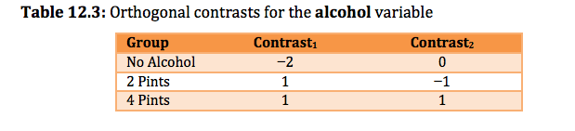
Orthogonal contrasts for the alcohol variable

Slide 16
Fitting a Factorial ANOVA Model
  gogglesModel<-aov(attractiveness ~ gender + alcohol + gender:alcohol, data = gogglesData)
Or:
  gogglesModel<-aov(attractiveness ~ alcohol*gender, data = gogglesData)
If we want to look at the Type III sums of squares for the model, we need to also execute this command after we have created the model:
  Anova(gogglesModel, type="III")

Slide 17
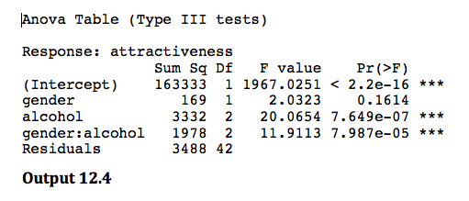
Interpreting Factorial ANOVA

Slide 18
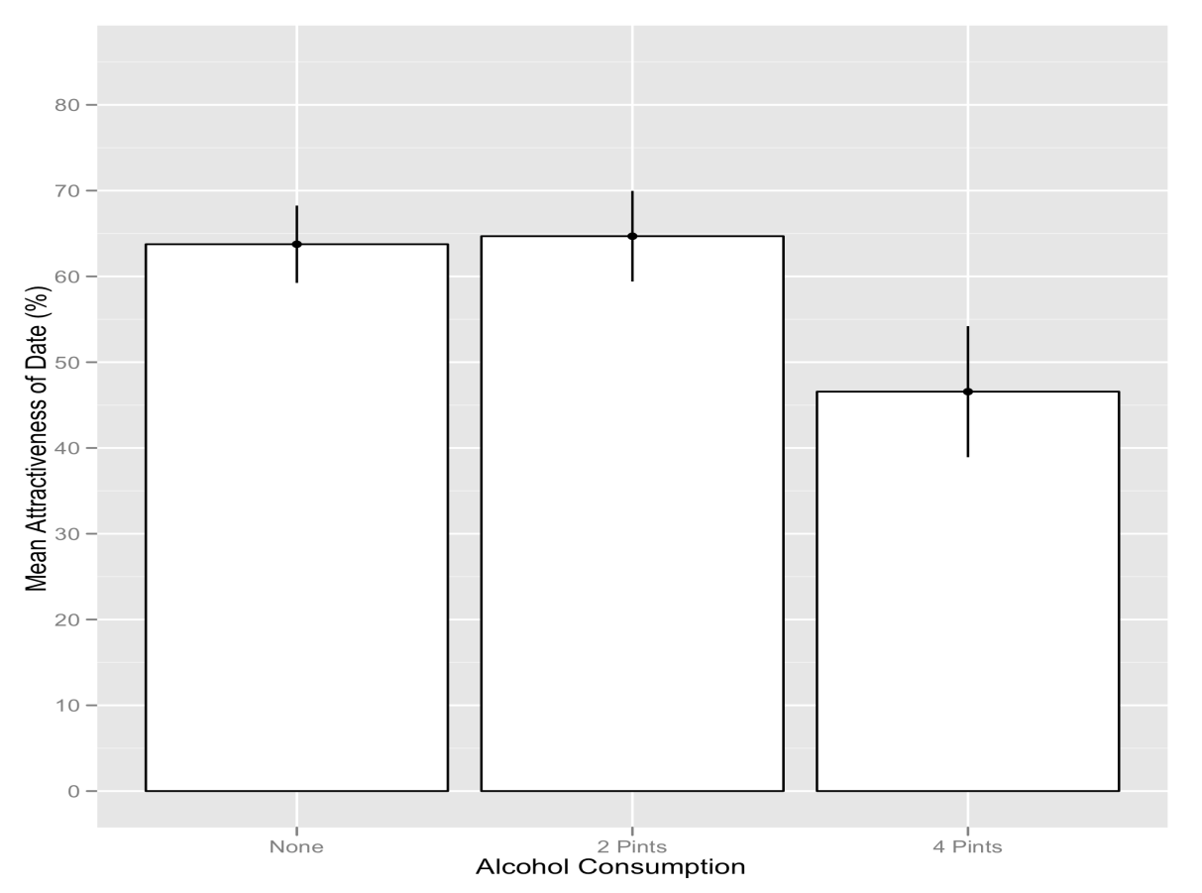
Interpretation: Main Effect Alcohol
There was a significant main effect of the amount of alcohol consumed at the nightclub, on the attractiveness of the mate that was selected, F(2, 42) = 20.07, p < .001.

Slide 19
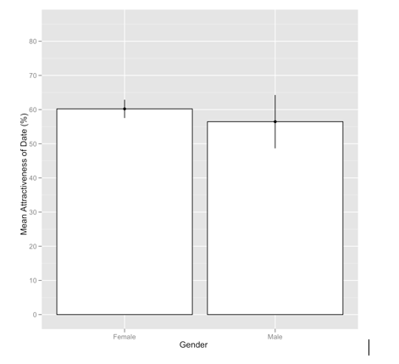
Interpretation: Main Effect Gender
There was a non-significant main effect of gender on the attractiveness of selected mates, F(1, 42) = 2.03, p = .161.

Slide 20
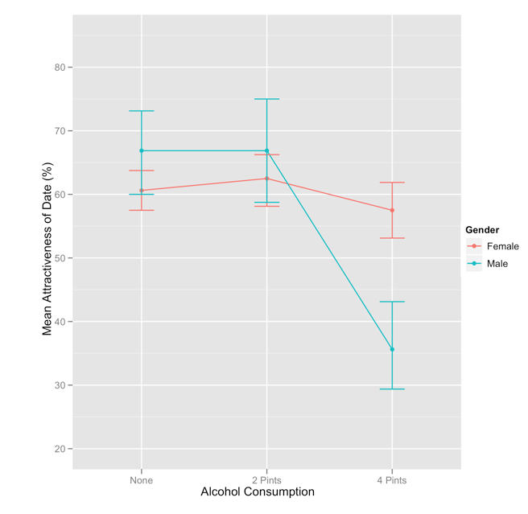
Interpretation: Interaction
There was a significant interaction between the amount of alcohol consumed and the gender of the person selecting a mate, on the attractiveness of the partner selected, F(2, 42) = 11.91, p < .001.
Notes:
The interaction shows non-parallel lines. That is, for low does of alcohol male and female scores do not change much. At a high dose (4 pints) male scores plummet but female scores remain fairly high. So, the interaction is caused by a difference between males and females in the effect of alcohol.

Slide 21
What Is an Interaction?
Notes:
The interaction shows non-parallel lines. That is, for low does of alcohol male and female scores do not change much. At a high dose (4 pints) male scores plummet but female scores remain fairly high. So, the interaction is caused by a difference between males and females in the effect of alcohol.

Slide 22
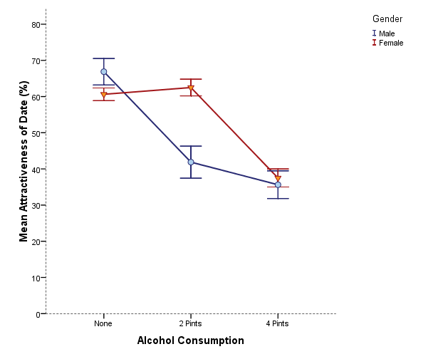
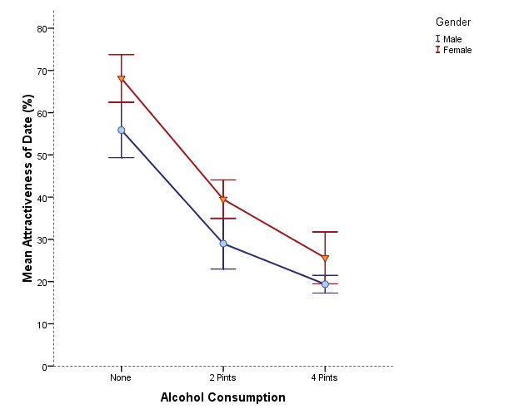
Is There Likely to Be a Significant Interaction Effect?
Yes
No

Slide 23
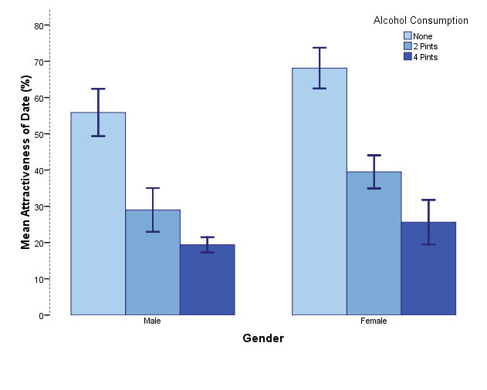
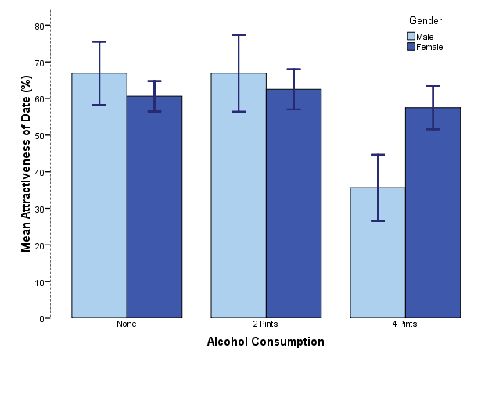
Is There Likely to Be a Significant Interaction Effect?
No
Yes

Slide 24
Interpreting Contrasts
To see the output for the contrasts that we specified, execute:
  summary.lm(gogglesModel)

Slide 25
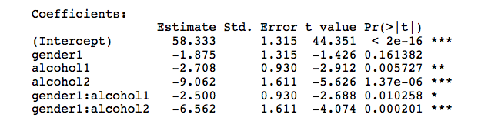
Interpreting Contrasts

Slide 26
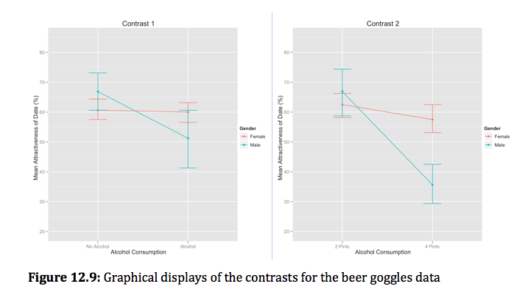
Interpreting Contrasts

